Slide 1
Intellij – Github - JUnit
Phong Vu
PhD Student
Dept. of Computer Science and Software Engineering
Auburn University

Slide 2
Table of content
How to basic: IntelliJ, Java, and Maven
Good stuff of the decade: JUnit
How to basic: Github and Git

Slide 3



How to basic: IntelliJ, Java, and Maven

Slide 4
How to basic: IntelliJ, Java, and Maven
IntelliJ:
An IDEA – Integrated Development Environment (The A doesn’t have any meaning)
Specialized for Java and Android Development
Installing IntellJ:
Go to https://www.jetbrains.com/idea/
Download Community version (FREE)

Slide 5
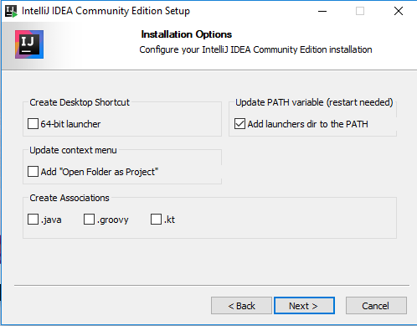
How to basic: IntelliJ, Java, and Maven

Slide 6
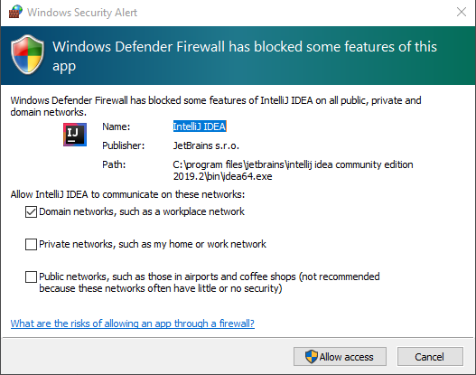
How to basic: IntelliJ, Java, and Maven

Slide 7
How to basic: IntelliJ, Java, and Maven
Installing JDK (Java Development Kit)
Required to develop Java applications
Link: https://www.oracle.com/technetwork/java/javase/downloads/index.html
What does it have?
Java runtime environment
Java debug environment
Java basic libraries
etc

Slide 8
How to basic: IntelliJ, Java, and Maven
A MAVEN project
“Maven is a powerful project management tool that is based on POM (project object model). It is used for projects build, dependency and documentation.”
– geeksforgeeks.org –
“Basically it saves you a lot of time to start and maintain a Java project.”
– Phong Vu -

Slide 9
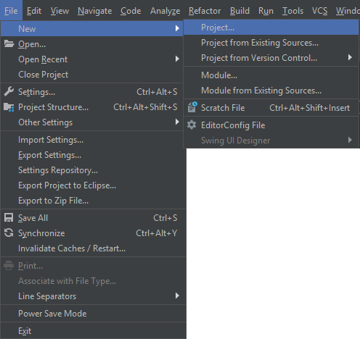
How to basic: IntelliJ, Java, and Maven
Step 1: Create a project

Slide 10
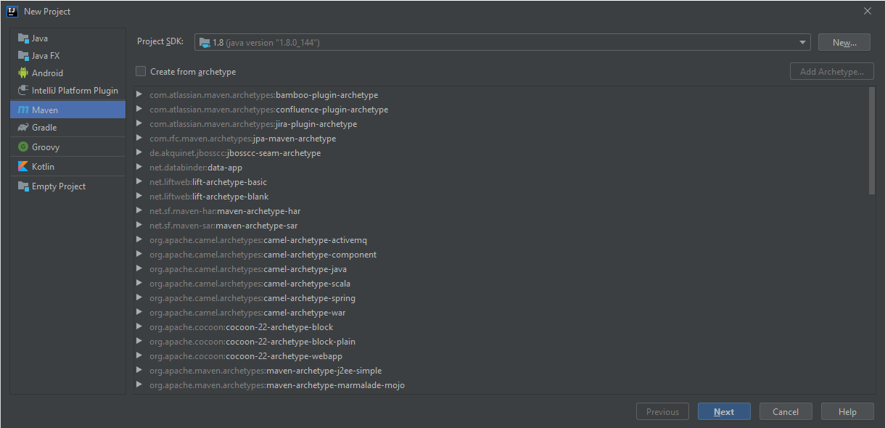
How to basic: IntelliJ, Java, and Maven
Step 2: Chose Maven

Slide 11
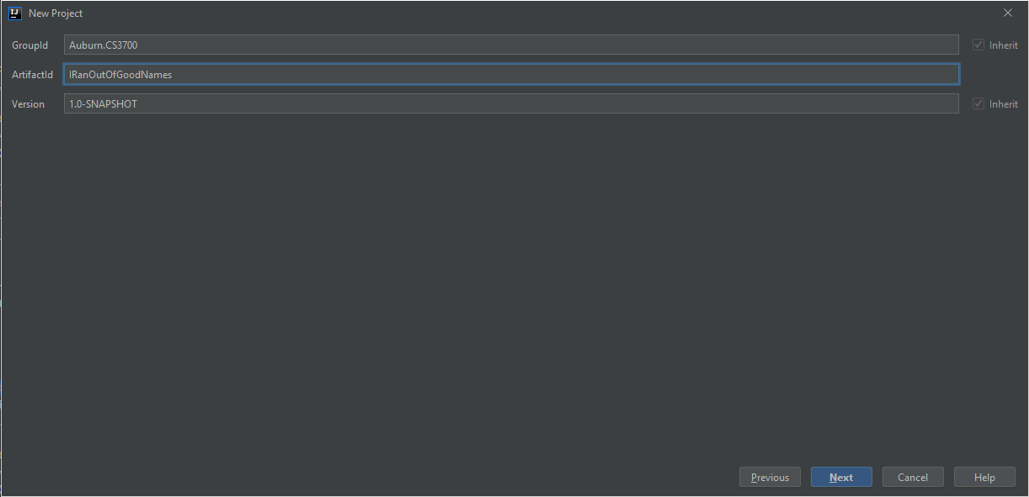
How to basic: IntelliJ, Java, and Maven
Step 3: Give it a name

Slide 12
How to basic: IntelliJ, Java, and Maven
Step 4: ?????????

Slide 13
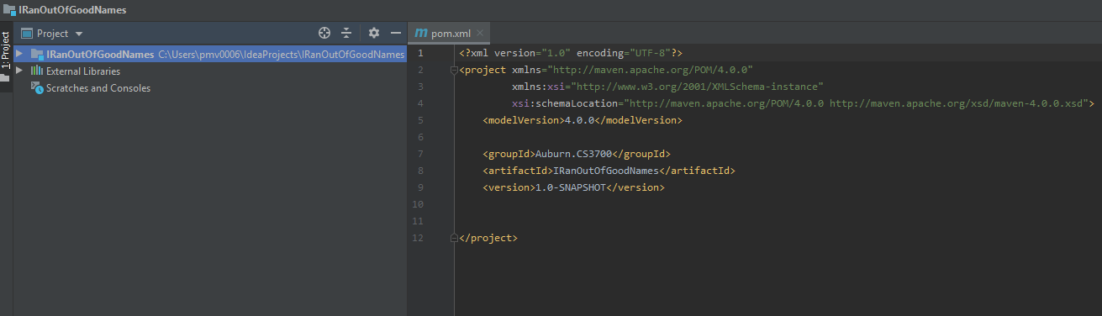
How to basic: IntelliJ, Java, and Maven
Step 5: profit

Slide 14

Good stuff of the decade: JUnit

Slide 15
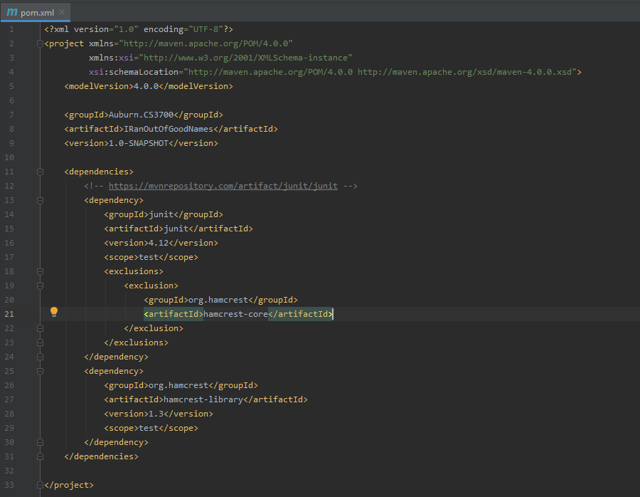
Good stuff of the decade: JUnit
Add Junit library to your pom.xml file:
<dependencies> <!-- https://mvnrepository.com/artifact/junit/junit --> <dependency> <groupId>junit</groupId> <artifactId>junit</artifactId> <version>4.12</version> <scope>test</scope> <exclusions> <exclusion> <groupId>org.hamcrest</groupId> <artifactId>hamcrest-core</artifactId> </exclusion> </exclusions> </dependency> <dependency> <groupId>org.hamcrest</groupId> <artifactId>hamcrest-library</artifactId> <version>1.3</version> <scope>test</scope> </dependency> </dependencies>

Slide 16
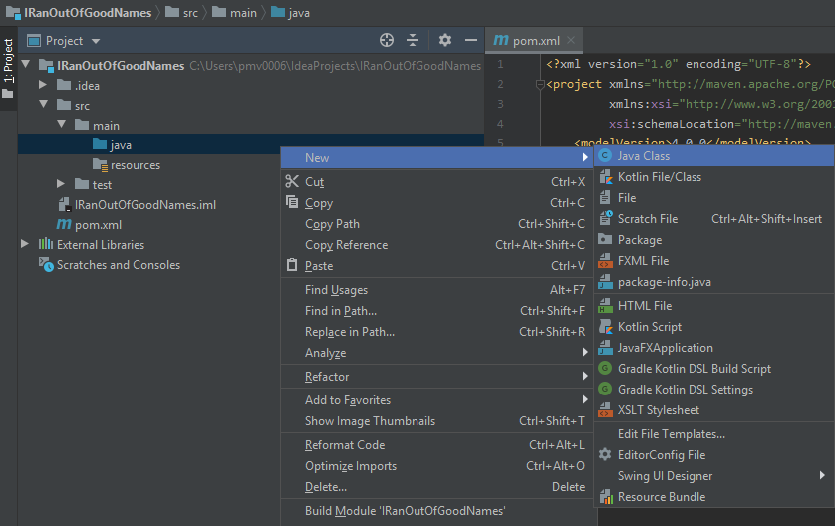
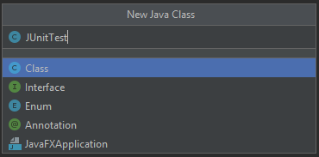
Good stuff of the decade: JUnit
Create a new Java class

Slide 17
Good stuff of the decade: JUnit
Basic annotations:
@BeforeClass – Run once before any of the test methods in the class, public static void
@AfterClass – Run once after all the tests in the class have been run, public static void
@Before – Run before @Test, public void
@After – Run after @Test, public void
@Test – This is the test method to run, public void

Slide 18
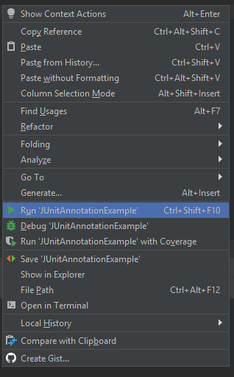
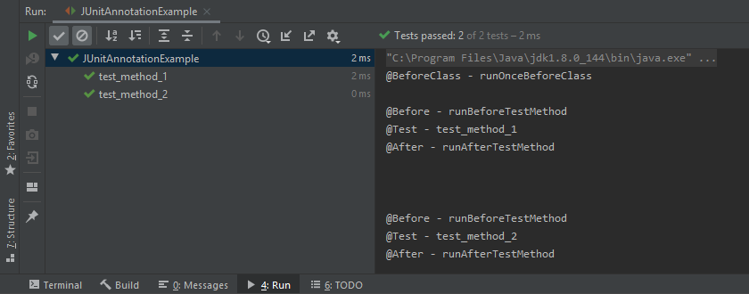
Good stuff of the decade: JUnit
Example code is in JUnitAnnotationExample.java

Slide 19
Good stuff of the decade: JUnit
JUnit comparision (assert) methods
If two objects/values are the same: AssertEqual
If an object has a certain attribute: AssertThat
If two arrays are the same: assertArrayEqual
etc
Example: JUnitSimpleDemonstration.java and SimpleOperations.java

Slide 20
Good stuff of the decade: JUnit
Learn more about JUnit: https://www.mkyong.com/tutorials/junit-tutorials/
Or just google it

Slide 21


How to basic: Github and Git

Slide 22
How to basic: Github and Git
Project management tool
Versioning control
Team work
Bug logger
Publication tool
etc

Slide 23
How to basic: Github and Git
How to start?
Download and install Git here: https://git-scm.com/
Create an account on GitHub: https://github.com/
Share your project on github
“Commit and push” everytime you change something

Slide 24
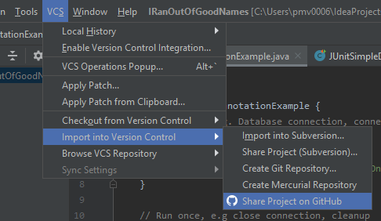
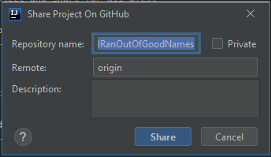
How to basic: Github and Git
Upload your project to the repository

Slide 25
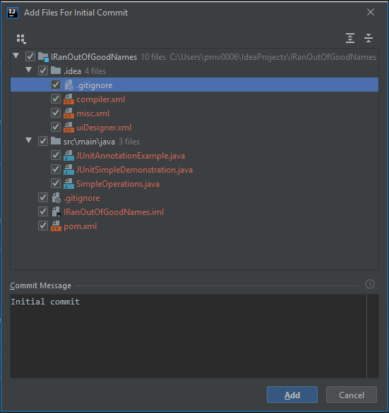
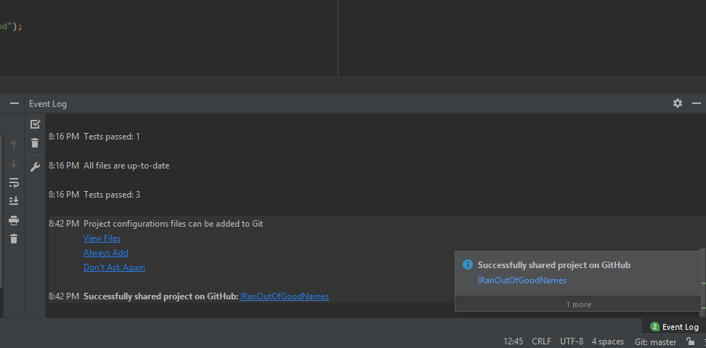
How to basic: Github and Git

Slide 26
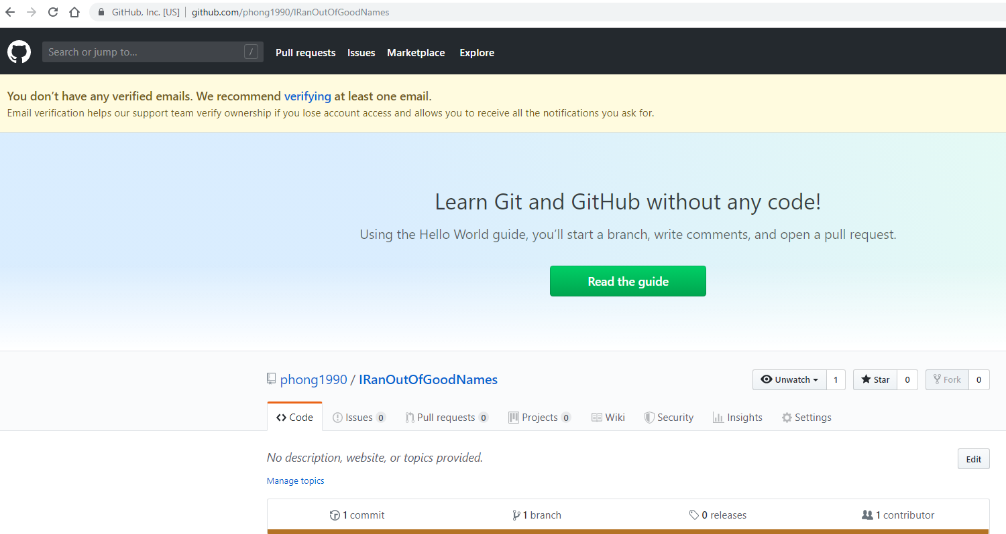

Slide 27
How to basic: Github and Git
“Commit and push” new changes
Commit: create a new version of your project in your local PC
Push: push that new version to Github

Slide 28
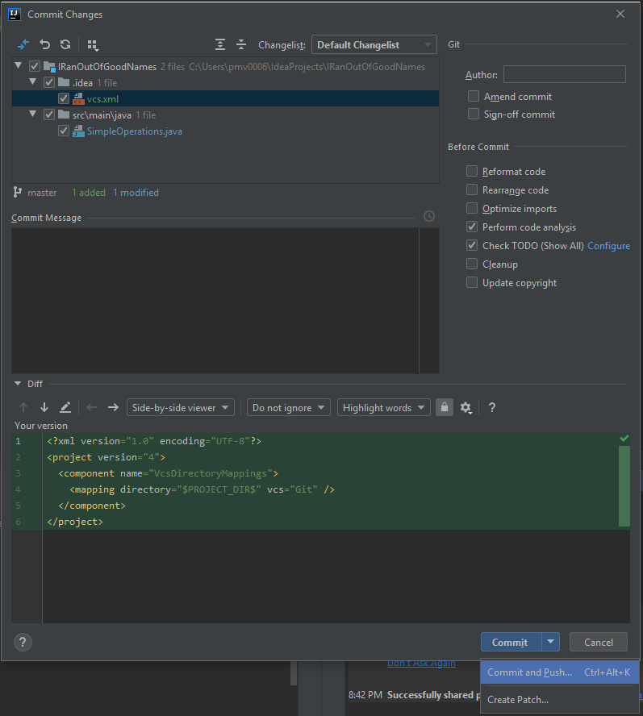
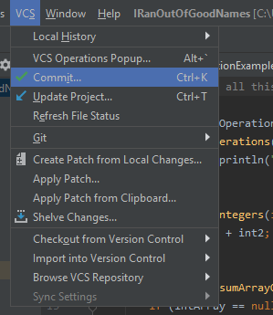
How to basic: Github and Git
“Commit and push” new changes

Slide 29
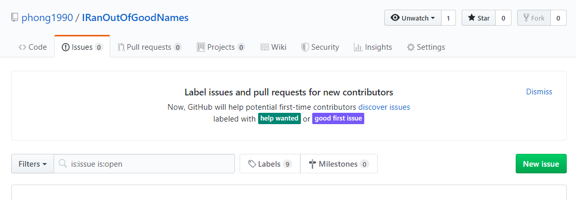
How to basic: Github and Git
Create and track issues/bugs

Slide 30
The End

